Slide 1
Solar battery charger circuit
Easy to construct
Cost efficient
Portable
Compact

Slide 2
About the project:
As there is an ongoing renewable power deficiency problem, our projects aims to give solution by providing a reliable source and a method to charge a few daily must need devices of 12V DC rating . Which can then be used directly or boosted to operate other necessary systems(Higher Rating Or Lower Rating). Our main goal is to power a 12V DC operated power devices which we will demonstrate by charging a 12V battery. As solar is the most reliable renewable source, we are limiting our input range to a voltage range around 4V to 6V that which is obtained by general portable solar cells. We are aiming to make our project as a small scale version of solar energy harvest, so that it is portable and cost friendly.

Slide 3
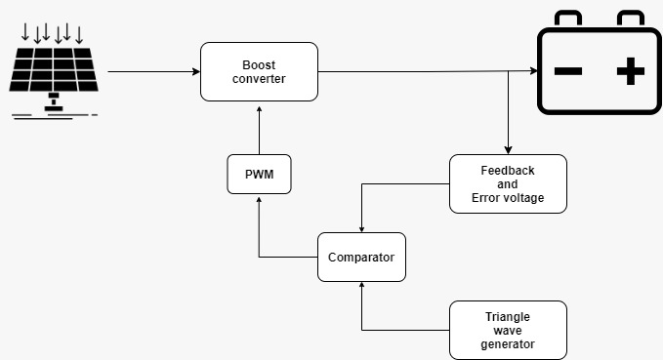
Block Diagram

Slide 4
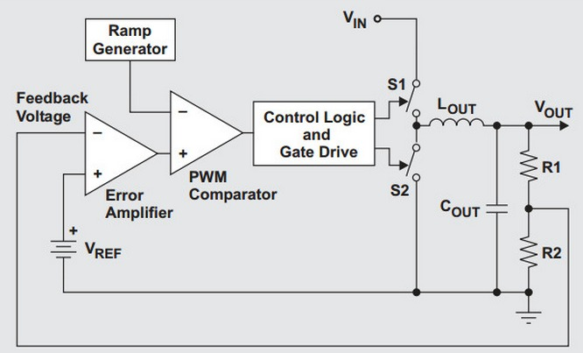
CHARGER CIRCUIT wITHOUT IC:
Circuit is simulated in NI MULTISIM

Slide 5
PARTS OF SIMULATION:
TRIANGLE WAVE GENERATOR
COMPARATOR
ERROR VOLTAGE GENERATOR
BOOST CONVERTER

Slide 6
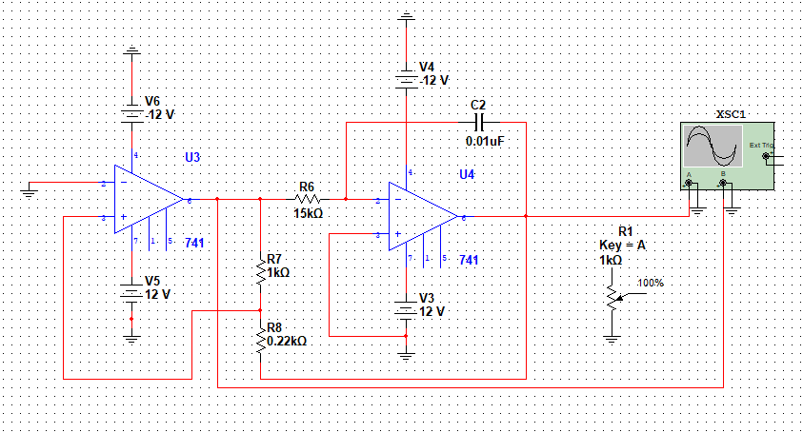
Triangular wave Generator:
This is a basic wave shaping circuit formed by square wave generator and integrator coupled in order to generate a triangular wave.

Slide 7
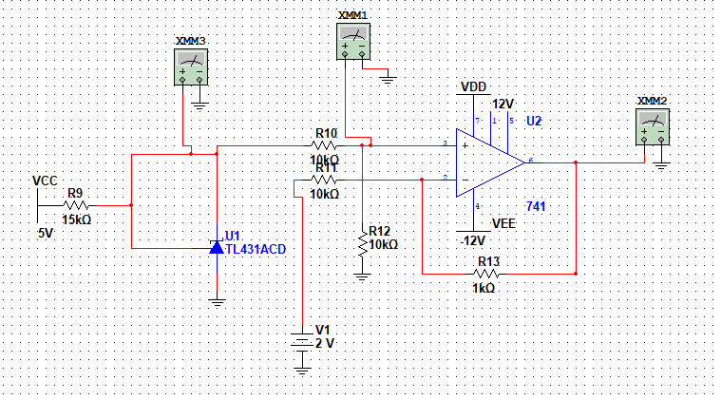
ERROR VOLTAGE GENERATOR:
This circuit compares the feedback component with a reference voltage and outputs a difference signal which is then used to generate duty cycle.

Slide 8
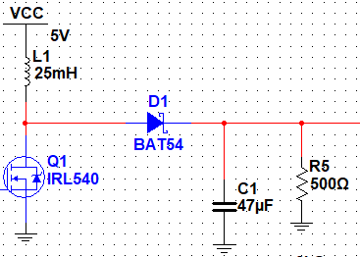
BOOST CONVERTER:
Circuit here is a basic construction of boost converter. It is designed to give a voltage of 15V when supplied with 5V.

Slide 9
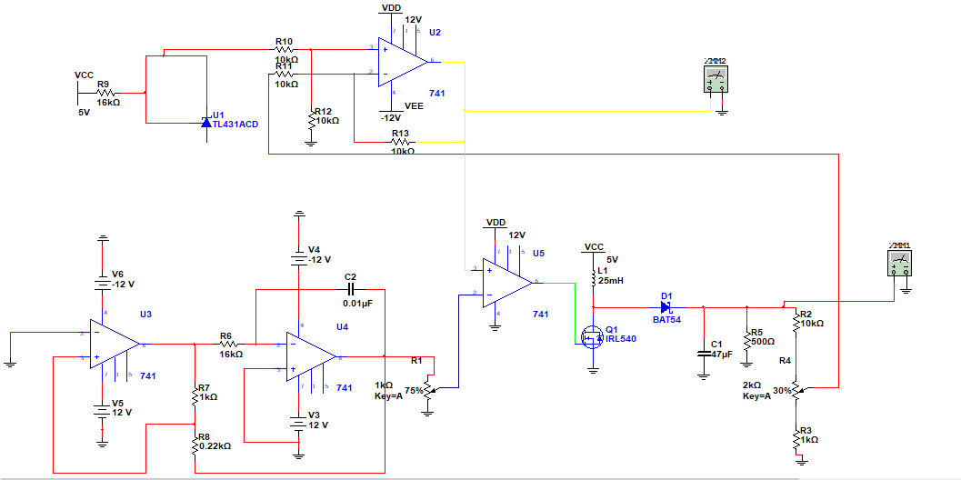
CIRCUIT simulation:

Slide 10
Working principle:
Initially, If there is a input voltage above 5V and initial feedback is 0V. Error voltage would be 2.5V and when it is compared with the triangle wave generated by wave shaping circuit, the comparator develops a duty cycle with almost 1. Hence the input voltage is boosted. While in the process when output voltage is increased the feedback fed is also increased which in turn reduces the error voltage. Because of this Duty cycle is reduced and output increases slowly. At certain point of time error voltage will be zero and duty cycle remains constant for constant input giving constant boosted output.
Now if this state is disturbed by either variation in input or variation in output, the duty cycle will be adjust itself to bring output back stable point.

Slide 11
For example, let's consider output is stable at 15V at error voltage as 0V. If output is increased, feedback increases, error voltage will become slightly negative and duty cycle is reduced below 50% which controls output by boosting less.
In case for some reason output is reduced, feedback reduces, error voltage is increased, increasing the duty cycle which in return boosts input more to get more output.

Slide 12
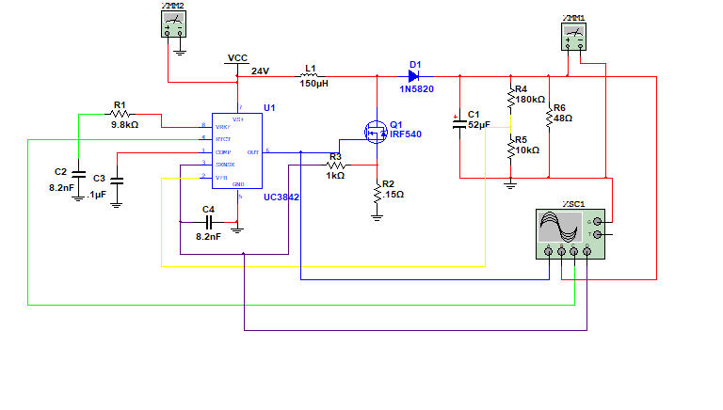
Alternative circuit: using uc3842
A replacement circuit in case needed a high power output.
It requires a minimum input voltage of > 10 volts to work

Slide 13
Thank you
From
Group 12
A. Meghasyam.
S. Shreekar.
A. Shanthan.
C. Surya Teja.

